Slide 1
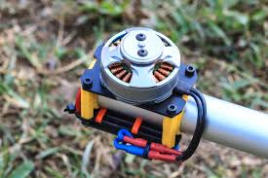
First Course of Special Machine
Department of Electrical Power and Machine Engineering
By Qasim Al Azze 2018

Slide 2
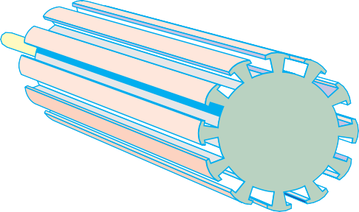
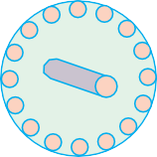
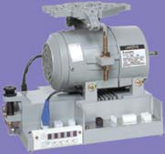
Single-phase Motors
1389
Fig. 36.41 Fig. 36.42
These motors can be reversed by the usual brush-shifting arrangement.
36.16. A.C. Series Motors
If an ordinary d.c. series motor were connected to an a.c. supply, it will rotate and exert unidirec- tional torque* because the current flowing both in the armature and field reverses at the same time. But the performance of such a motor will not be satisfac- tory for the following reasons :
the alternating flux would cause excessive eddy current loss in the yoke and field cores which will become extremely heated.
vicious sparking will occur at brushes because of the huge voltage and current induced in the short-circuited armature coils during their commutation period.
power factor is low because of high inductance of the field and armature circuits.
Induction type AC sevro motor and control box
However, by proper modification of design and other refinements, a satisfactory single-phase motor has been produced.
The eddy current loss has been reduced by laminating the entire iron structure of the field cores and yoke.
Power factor improvement is possible only by reducing the magnitudes of the reactances of the field and armature windings. Field reactance is reduced by reducing the number of turns on the field windings. For a given current, it will reduce the field m.m.f. which will result in reduced air- gap flux. This will tend to increase the speed but reduce motor torque. To obtain the same torque, it will now be necessary to increase the number of armature turns proportionately. This will, however, result in increased inductive reactance of the armature, so that the overall reactance of the motor will not be
* However, torque developed is not of constant magnitude (as in d.c. series motors) but pulsates between zero and maximum value each half-cycle.

Slide 3
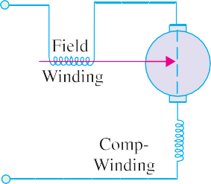
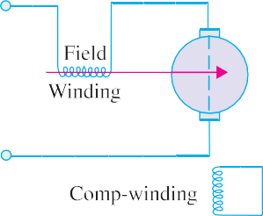
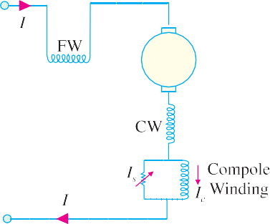
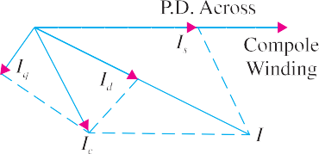
1390
Electrical Technology
significantly decreased. Increased armature m.m.f. can be neutralized effectively by using a compensating winding. In conductively- compensated motors, the compensating winding is connected in series with the armature [Fig.
36.43 (a)] whereas in inductively- compensated motors, the
compensating winding is short- circuited and has no interconnection with the motor circuit [Fig. 36.43
Fig. 36.43
(b)]. The compensating winding acts as a short-circuited secondary of a transformer, for which the armature winding acts as a primary. The current in the compensating winding will be proportional to the armature current and 180º out of phase with it.
Generally, all d.c. series motors are ‘provided’ with commutating poles for improving commutation (as in d.c. motors). But commutating poles alone will not produce satisfactory commutation, unless something is done to neutralize the huge voltage induced in the short-circuited armature coil by transformer action (this voltage is not there in d.c. series motor). It should be noted that in an a.c. series motor, the flux produced by the field winding is alternating and it induces voltage (by transformer action) in the short-circuited armature coil during its commutating period. The field winding, associated with the armature coil undergoing commutation, acts as primary and the armature coil during its commutating period acts as a short-circuited secondary. This transformer action produces heavy current in the armature coil as it passes through its commutating period and results in vicious sparking, unless the transformer voltage is neutralized. One method, which is often used for large motors, consists of shunting the winding of each commutating pole with a non-inductive resistance, as shown in Fig. 36.44 (a).
Fig. 36.44
Fig. 36.44. (b) shows the vector diagram of a shunted commutator pole. The current I_{c} through the commutating pole (which lags the total motor current) can be resolved into two rectangular com- ponents I_{d} and I_{q} as shown. I_{d} produces a flux which is in phase with total motor current I whereas flux produced by I_{q} lags I by 90º. By proper adjustment of shunt resistance (and hence I_{s}), the speed voltage generated in a short-circuited coil by the cutting of the 90º lagging component of the commu- tating pole flux may be made to neutralize the voltage induced by transformer action.
36.17. Universal Motor
A universal motor is defined as a motor which may be operated either on direct or single-phase

Slide 4
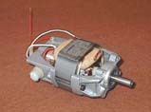
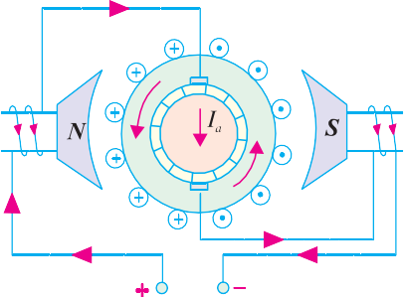
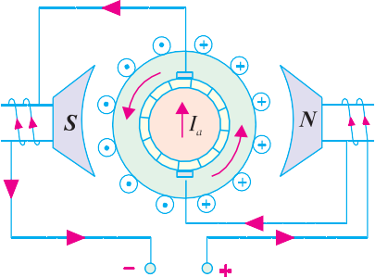
Single-phase Motors
1391
supply at approximately the same speed and output.
In fact, it is a smaller version (5 to 150 W) of the a.c. series motor described in Art. 36.16. Being a series-wound motor, it has high starting torque and a variable speed characteristic. It runs at dan- gerously high speed on no-load. That is why such motors are usually built into the device they drive.
Generally, universal motors are manufactured in two types:
concentrated-pole, non-compensated type (low power rating)
distributed-field compensated type (high power rating)
The non-compensated motor has two salient poles and is just like a 2-pole series d.c. motor except that whole of its magnetic path is laminated (Fig. 36.45). The lami- nated stator is necessary because the flux is alternating when motor is operated from a.c. supply. The armature is of wound type and similar to that of a small d.c. motor. It consists essentially of a laminated core having either
straight or skewed slots and a commu- tator to which the leads of the arma-
Universal motor.
ture winding are connected. The distributed-field compensated type motor has a stator core similar to that of a split-phase motor and a wound armature similar to that of a small d.c. motor. The compensating winding is used to reduce the reactance voltage present in the armature when motor runs on a.c. supply. This voltage is caused by the alternating flux by transformer action (Art. 36.16).
In a 2-pole non-compensated motor, the voltage induced by
DELL
2018-11-21 17:17:01
--------------------------------------------
advantage of compensated type
Fig. 36.45
transformer action in a coil during its commutation period is not sufficient to cause any serious com- mutation trouble. Moreover, high-resistance brushes are used to aid commutation.
Fig. 36.46 Fig.36.47
(a) Operation. As explained in Art. 36.16, such motors develop unidirectional torque, regard- less of whether they operate on d.c. or a.c. supply. The production of unidirectional torque, when the motor runs on a.c. supply can be easily understood from Fig. 36.46. The motor works on the same principle as a d.c. motor i.e. force between the main pole flux and the current-carrying armature conductors. This is true regardless of whether the current is alternating or direct (Fig. 36.47).

Slide 5
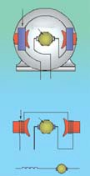
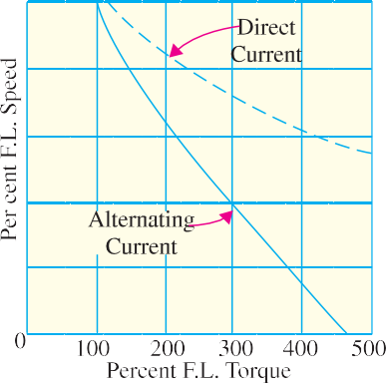
1392
Electrical Technology
Speed/Load Characteristic. The speed of a universal motor varies just like that of a d.c. series motor i.e. low at full-load and high on no-load (about 20,000 r.p.m. in some cases). In fact, on no-load the speed is limited only by its own friction and windage load. Fig. 36.48 shows typical torque characteristics of a universal motor both for d.c. and a.c. supply. Usually, gear trains are used to reduce the actual load speeds to proper values.
Applications. Universal motors are used in vacuum cleaners where actual motor speed is the load speed. Other applications where motor speed is reduced by a gear train are : drink and food mixers, portable drills and domestic sewing machine etc.
Reversal of Rotation. The concentrated-pole (or salient-pole) type universal motor may be reversed by reversing the flow of current through either the armature or field windings. The usual method is to interchange the leads on the brush holders (Fig.36.49).
The distributed-field compensated type universal motor may be reversed by interchanging either the armature or field leads and shift- ing the brushes against the direction in which the motor will rotate. The extent of brush shift usually amounts to several commutator bars.
Field Coil
Armature
+
–
Series Field
Armature
+
–
₊ Series –
Arm
Universal motor with interchangeable parts for mixing solids, liquids semi- solids and coating.
Fig. 36.48
36.18. Speed Control of Universal Motors
Fig.36.49
The following methods are usually employed for speed-control purposes :
Resistance Method. As shown in Fig. 36.50, the motor speed is controlled by connecting a variable resistance R in series with the motor. This method is employed for motors used in sewing machines. The amount of resistance in the circuit is changed by means of a foot-pedal.
Tapping-field Method. In this method, a field pole is tapped at various points and speed is controlled by varying the field strength (Fig. 36.51). For this purpose, either of the following two arrangements may be used :
The field pole is wound in various sections with different sizes of wire and taps are brought out from each section.
Nichrome resistance wire is wound over one field pole and taps are brought out from this wire.

